Slide 1

ATPG for Synchronous Sequential Circuits
ELEC-7950 Spring 2016
Speaker ：Mi Yan
Student number：mzy0018

Slide 2

ATPG for Synchronous Sequential Circuits
Background of The Subject
Sequential versus
combinational circuits
contents
A simple sequential circuit
with a stuck-at-0 fault
Time frame expansion method
Conclusion

Slide 3
ATPG for Synchronous Sequential Circuits
background
Automatic Test Pattern Generation
Automatic Test Pattern Generator
distinguish between the correct circuit behavior and the faulty circuit behavior
electronic design automation technology
used to find an input (or test) sequence
digital circuit
test equipment
caused by defects

Slide 4
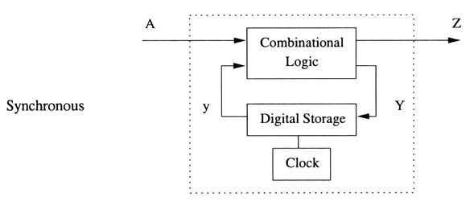
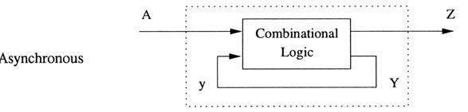
ATPG for Synchronous Sequential Circuits
Sequential circuits fall into two classes:
synchronous and asynchronous.
first
second
synchronous: D-type flip-flop, the JK flip-flop and their derivatives.
Asynchronous: sequential circuits the inputs are levels and there are no clock pulses; the inputs events drive the circuit.
third

Slide 5
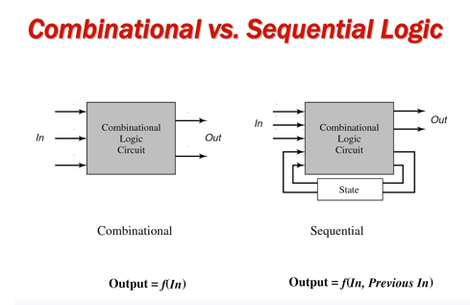
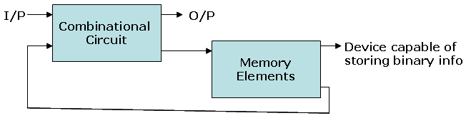
ATPG and testing: Sequential versus combinational circuits

Slide 6

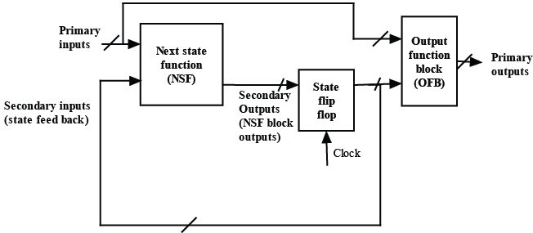
ATPG and testing: Sequential versus combinational circuits
Basic architecture of a sequential circuit
Once indirect controllability and observability are achieved, ATPG for these combinational blocks can be done using D-algorithm or any other combinational APTG algorithm.

Slide 7
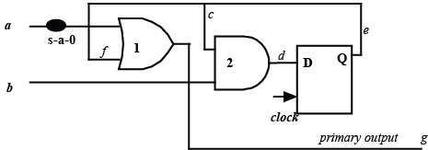
A simple sequential circuit with a stuck-at-0 fault
s-a-0 fault at net a
gate-1 corresponds to the OFB
gate-2 is for the NSF
D-flip flop is the memory element.

Slide 8
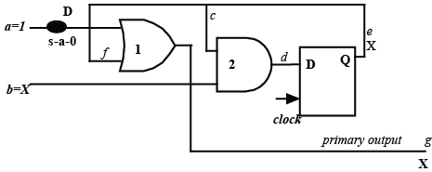
A simple sequential circuit with a stuck-at-0 fault
Problems in ATPG for the stuck-at-0 fault
flip-flop can have any signal value (marked as X). So testing the s-a-0 fault is not as simple as in case of combinational circuits.

Slide 9

A simple sequential circuit with a stuck-at-0 fault
Indirect controlling of f to 0
first make net d=0, following transfer the value of d to f , then a =1 and b =X

Slide 10
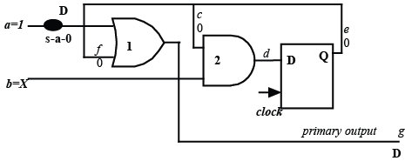
A simple sequential circuit with a stuck-at-0 fault
Test pattern for the s-a-0 fault
ATPG for combinational blocks in sequential circuits require more than one pattern.
In this example, the first pattern is a =X, b =0 and clock edge followed by a =1 and b =X.

Slide 11
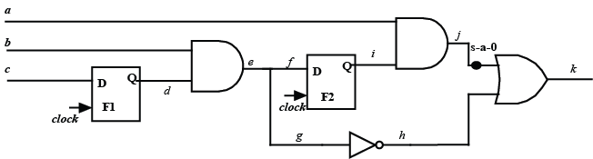
ATPG of sequential circuits: Time frame expansion method
Sequential circuits with a s-a-0 fault
ATPG steps:
flip-flops
net
values of primary inputs
D-algorithm
required signals
values of secondary inputs
Secondary inputs

Slide 12
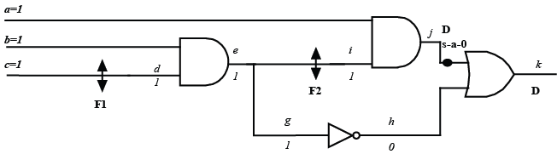
ATPG for sequential circuits using the time frame expansion approach
replace the flip-flops with nets

Slide 13
disuses the following definitions
Sequential depth of a flip-flop
If the output of a flip-flop can be controlled by only primary inputs (and a clock pulse) it has sequential depth of 1.
A flip-flop has a sequential depth of d_{seq} if its output is dependent on primary inputs and at least one flip-flop of depth d_{seq}-1.
Ⅰ

Slide 14
disuses the following definitions and conditions
Non-cyclic Circuit
A sequential circuit is non-cyclic if there is no flip-flop whose input is dependent on its output.
Ⅱ

Slide 15
three time steps
time step-1
Set primary inputs such that F1 is set appropriately which (along with primary inputs) can enable F2 to be 1 in Time Step-2. As i is to be 1 in Time Step-2, so d is to be made 1 by making primary input c =1 (in Time Step-1). Other primary inputs are don't cares in this step. Finally a clock pulse is given.

Slide 16
three time steps
Time step-2
Net d =1 from settings in Step-1. Now we need to appropriately set primary inputs such that F2 is 1 and along with it F1 is also 1, in Time Step-3. To make F2=1 (having set d=1) we need to have b =1. Also, to have F1=1 we need to have c =1. The other primary input a is don't care. Finally a clock pulse is given.

Slide 17
three time steps
Time step-3
So we have d =1 and i =1, from the setting in Time Step-2; equivalently F1=1 and F2=1. Now as per the test pattern given in Figure 11, primary input a =1 and b =1 would result in D at the output.

Slide 18
Test pattern
(i) a =X, b =X, c =1 (clock pulse)
(ii) a =X, b =1, c =1 (clock pulse)
(iii) a =1, b =1, c =X.

Slide 19
Conclusion
Need multiple patterns and clock pulses
So applying the patterns for testing a sequential circuit involves much more test time than a combinational circuit
The complexity of ATPG algorithms for sequential circuits is higher than of combinational ones
The problem was the controllability of secondary inputs and observability of secondary outputs.

Slide 20
Reference
V.D. Agrawal, K.T. Cheng, P. Agrawal: “A directed search method for test generation using a concurrent fault simulator,” IEEE Transactions on Computer-Aided Design, Vol. 8, n. 2, February 1989, pp. 131–138
F.P.M. Beenker, K.J.E. van Erdewijk, R.B.W. Geritzen, F.F. Peacock, M. van der Star: “Macro Testing: Unifying IC and Board Test,” IEEE Design & Test of Computers, December 1986, pp. 26–32
W.T. Cheng: “The Back Algorithm for sequential test generation,” ICCD'88: IEEE International Conference on Computer Design, Rye Brook, NY (USA), October 1988, pp. 66–69
H. Fujiwara: “Logic testing and design for testability,” The MIT Press, Cambridge, MA (USA), 1975
Mano, M. Morris,. Digital Design, 2/e. Prentice-Hall of India . 1995.

Slide 21


Thank you for your time!

